Slide 1
Training and Mentoring
CDI Internal Advisory Board
June 25, 2025
Dave Bridges (Associate Director of Trainee Development)
Durga Singer (Associate Director of Training and Mentoring)
Notes:
Questions Metrics for success and 10 year plan for success (Julie L.)
Branch out for a diabetes specific group from the K writing workshop (Vickie Ellingrod)
How to work with FFMI for career trajectories into industry (Karl J.) Add in Brehm Coalition info from Martin from entry points
Add in CTRSP program to pipeline Add in High School training program from Martin to entry points
EAB Comments
Pipeline of future researchers including lab staff is extremely important
Trainee council for guiding the program

Slide 2

Major Goals
Create
Create an environment where learners at different stages feel supported.
Provide
Provide a combination of community building and career development opportunities.
Engage
Engage mentors in continued mentor learning opportunities.
Connect
Connect faculty, staff and learners to opportunities from campus.

Slide 3
Challenges
Trainees and Labs are Spread Across Campus
NCRC
Brehm Tower
Central Campus
Remote work
Lack of community, difficult to network outside of lab environment
Poor awareness of the large number of campus resources

Slide 4
Steps to build CDI learning community
Identify trainees
Set up website for resources
Develop useful resources and workshops
Networking and social events
Notes:
https://diabetes.med.umich.edu/enrichment-training-funding/training-mentoring

Slide 5
Identifying our trainees
148 trainees
Published 182 papers in last year
51 funded by NIH (15 F31, 5 F32,2 K01, 8 K08, 12 K23, and 5 K99)
47 students
100 postgraduate
38 PhD
3 MD/PhD
6 MS
Physiology (26), Neuroscience (19), Nutrition (10), Biostats (8), Immunology (6), Nutrition (10), BME (10), Pediatrics (3)
To be added email TrainingandMentoringAdmin@umich.edu

Slide 6
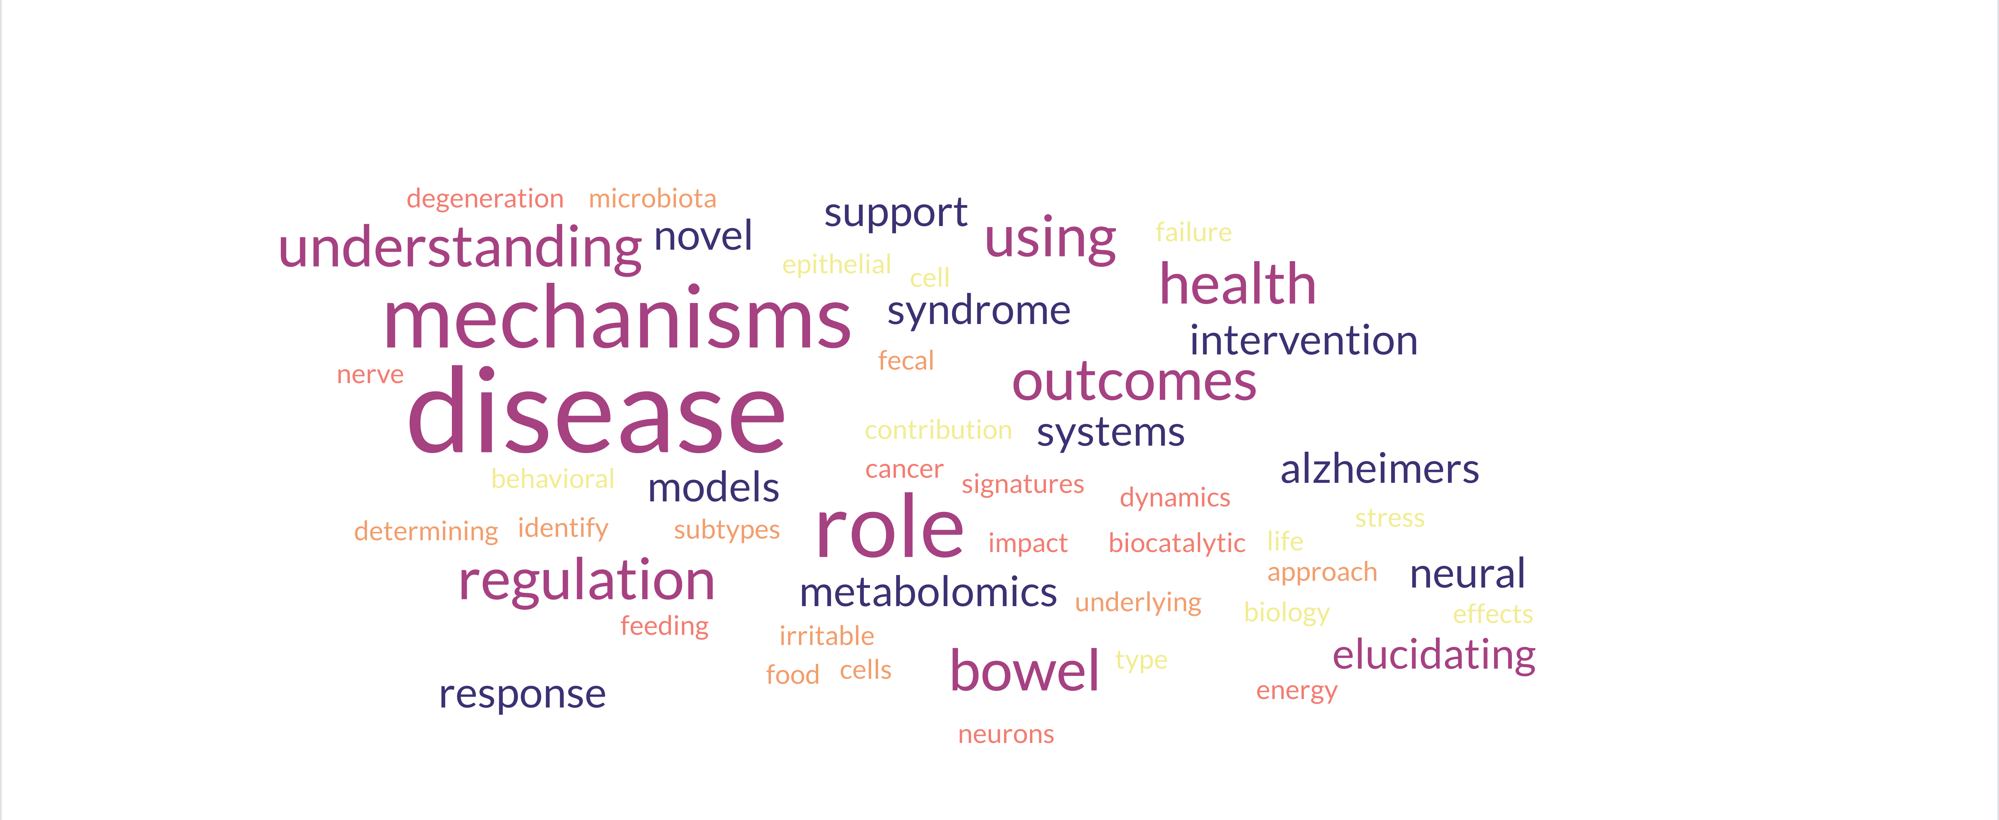
NIH Funded Fellowships from CDI Trainees

Slide 7
Plan for Mentors and Mentees
Michigan Medicine Resources
K-Clubs/Workshops
LAUNCH Committees
R01 Bootcamp

Slide 8
Current Progress
Existed already | CDI Symposia Research Clubs
Built this year | Process for Identifying Trainees Landing Page Career Development Series Fellowship Workshop Meetings with External Speakers Social Events
Future Plans | Research Workshops Writing Groups Awards Newsletter Near-Peer Mentoring Alumni Events

Slide 9

Monthly CDI Professional Development Series
Defining Your Leadership Style
Mentoring and Mentoring Plans
Women in Science Leadership Event
Finding Funding (and Managing Uncertainty)
Creating and Effective Presentation
Networking (with an Ice Cream Social Event)
Using AI in Research
Developing your Teaching Philosophy

Slide 10
F31/F32 Writing Workshop
Bi-weekly workshop

Slide 11
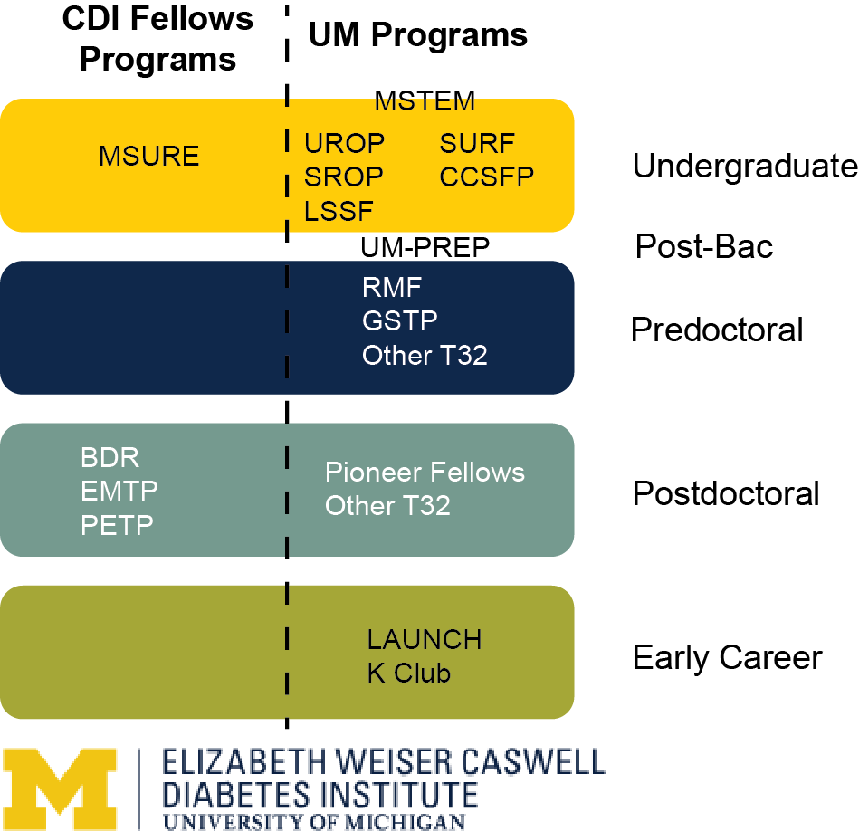
Next Steps
Clarifying trainee population
Website updates
Clarifying entry points
Sharing funding opportunities
Workshops
Technical skills
Jobs and alumni
Feedback from trainees
Awarding excellence
Future of Metabolic Physiology Symposia

